Slide 1
Spring Boot

Slide 2
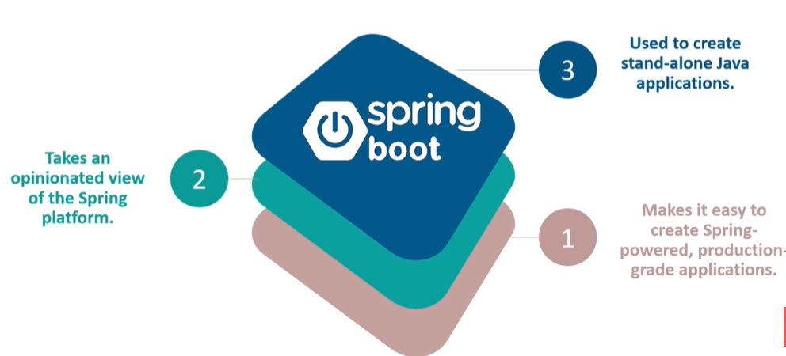
What is Spring Boot?

Slide 3
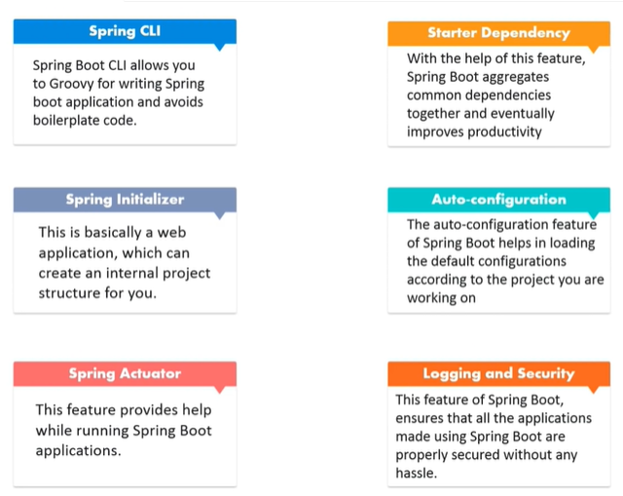
Features of Spring Boot

Slide 4
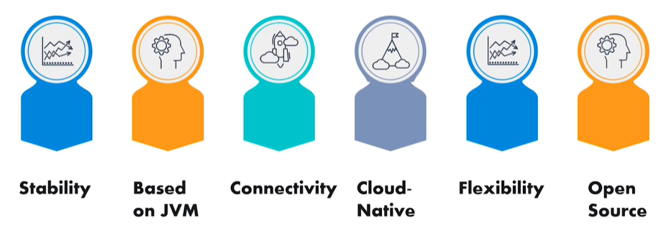
Why should I need to learn Spring Boot?

Slide 5
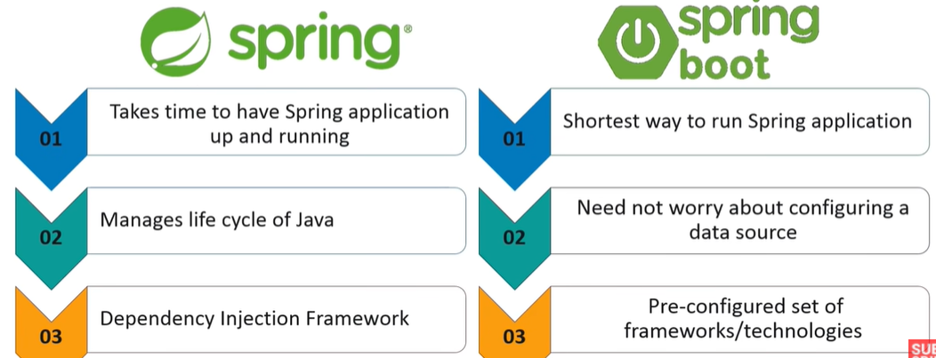
Spring vs. Spring Boot

Slide 6
What is MVC?
It is a Java Framework which is used to build web applications
It based on Model-View-Controller Design Pattern
It also implements all the basic features of a core Spring Framework like Dependency Injection.

Slide 7
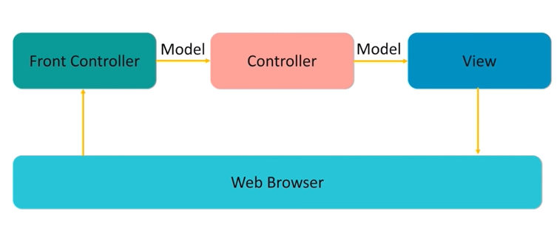
MVC Diagram

Slide 8
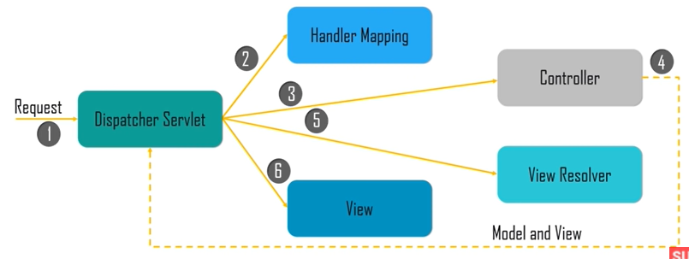
MVC Workflow

